Slide 1
No mail today ..... I'm Here with my "boat" on leave; Daaaag!

Slide 2
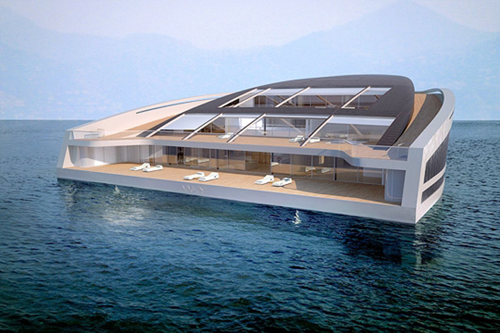
A famous French shipbuilder ship company and one of Monaco joined hands together to build this yacht with enormous dimensions: the WHY 58x38. (58meter long and 38 meter wide) After the first pictures of this project.

Slide 3
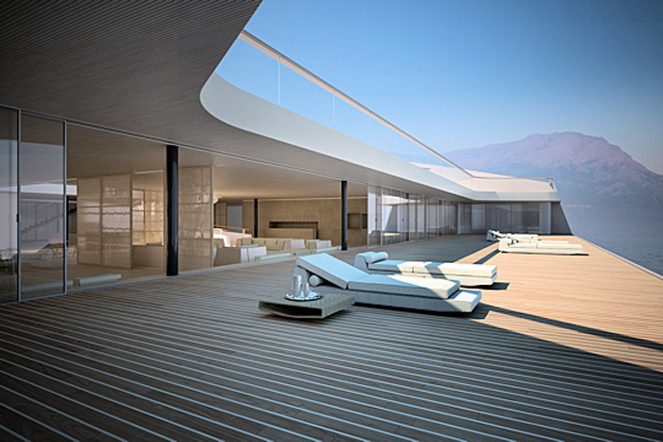
The yacht, an area of 3400 m2 with seating for 12 passengers and 20 crew.

Slide 4
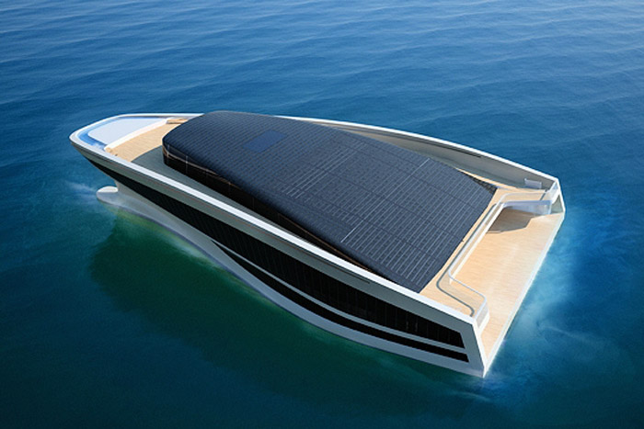
This is a "green" yacht. Wally et HermÃ¨s use green energy to 20 to 30% fuel savings and 40 to 50% electricity consumption on board. Therefore there are 900 m2 equipped with solar panels, producing a daily output of 500 kW.

Slide 5
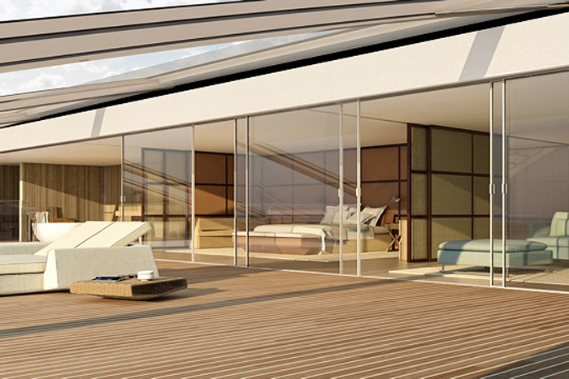
equipment: Three decks, a 25 meter pool, a spa helicopterpad a 100m2 with hammam, sauna, gym and massage room, a promenade of 130 meter, a music room, a dining room, a cinema, sun decks, suites, terraces, a lounge, a bibi . The luxury is at the rendez-vous. The decks are connected by stairs but there is also an elevator.

Slide 6
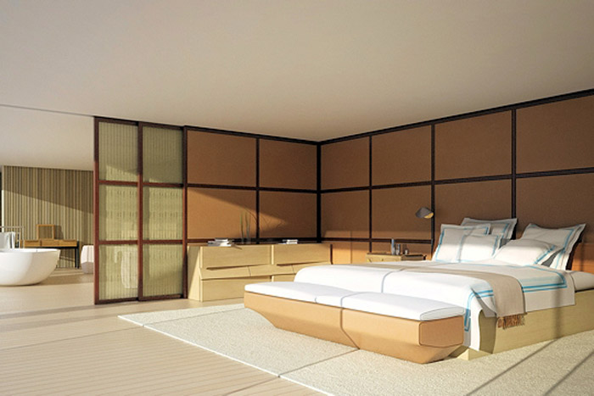
The suite of the owner (ie ikke !!!!!): With an area of 200m2 and completely covers the third deck. (This is the bedroom) The sea view is great and there is a private terrace of 25 meter long.

Slide 7
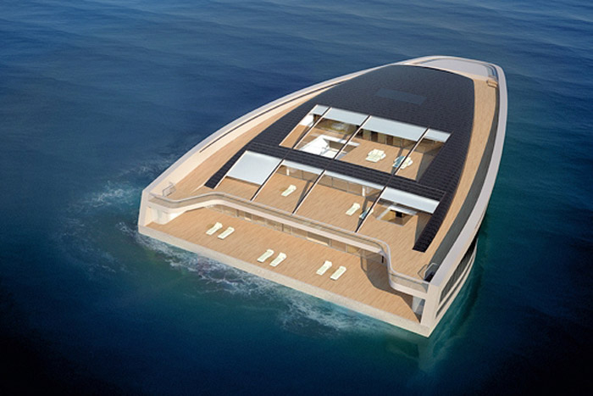
A sea of light. The yacht has the shape of a horseshoe and has a roof so everything is bathed in a sea of light.

Slide 8
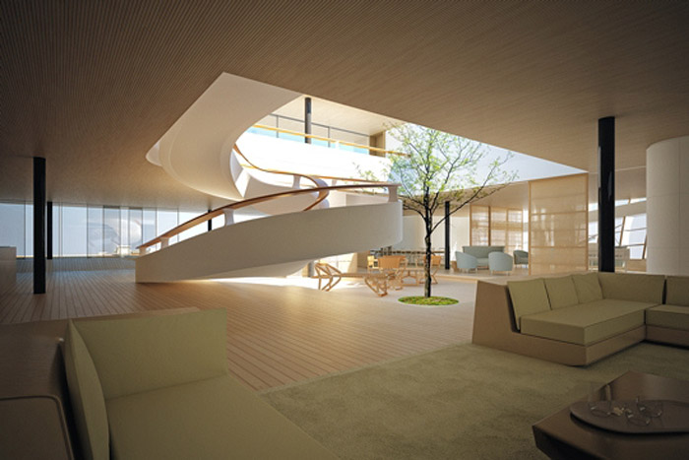
The spacious lounge. On the lower deck are the common premises, such as lounge, piano bar and dining area .....

Slide 9
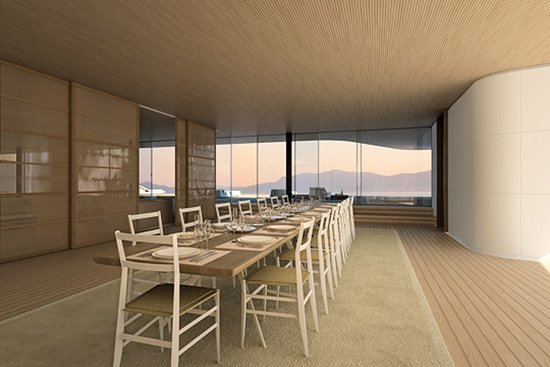
Dining Room The dining room opens onto the sea view.

Slide 10
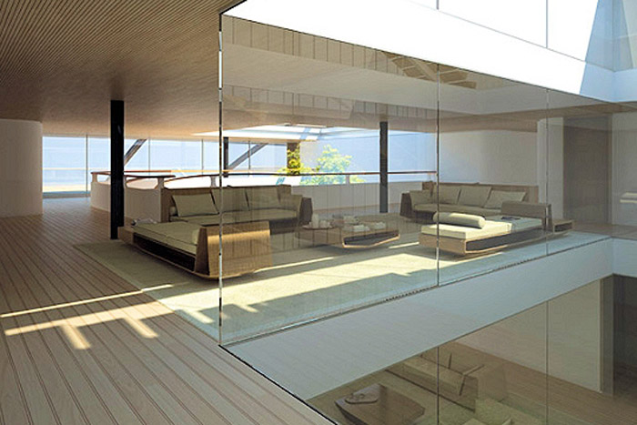
Suites for the guests For the guests, 5 suites with sea views (on the middendek). There is also a reading room equipped.

Slide 11
